Slide 1
PAUSE TO RESUME
Developed by,
Exception Handlers
Rintu Reji
Kripa S Mathew
Sandhu Sara Kurian

Slide 2


Slide 3
PROBLEM STATEMENTS
During this current pandemic caused by corona virus, people are
manually entering their contact details when they visit hospitals,
shops etc.
While this manual data entry, there is a high chance of disease spread
due to close contact with the means used for data entry
Also, some people may even ignore this step and go ahead or may
enter false details.
The travel history of people cannot be properly recorded with this
pen-and-paper system.
Neither the shopkeeper nor the fellow customers are not been informed if any of the customers visited are being tested positive for corona.

Slide 4
MOTIVATION BEHIND CHOOSING THIS ISSUE
We personally faced inconvenience with the current system of data entry and have seen many people skipping this step.
This is one of the major reasons of rapid spread of corona virus
due to:
unawareness about fellow customers who were tested positive for the disease.
Even if people come to know about the latter, people don't inform government and continue to go outdoors and worsen the condition.

Slide 5


Slide 6
We introduce our innovative idea to tackle the mentioned problems.
PauseToResume is a small device which can be placed at the entrance of
shops,hospitals,banks etc.
A person must show the QR code of any Id card(preferably Aadhar)
infront of our device. It is a mandatory step for any person to enter
into a public place.
Otherwise, our device will produce alarms which can be heard by the
shopkeeper.
The device will scan the QR code, filters it and take only essential
information like name,address and phone no of user. Security of the
user is guaranteed by us.
The collected data will be stored in a cloud based database and the
covid case reports in a locality is also stored in this databse.This is
cross checked with our data daily , if any of the person visited that
place is tested positive for covid, the shop keeper and people visited
the shop will be send an SMS informing the same.
To ensure proper action for this,we will also send SMS to ward
members to make mandatory quarantine of suspected individuals.

Slide 7

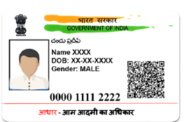
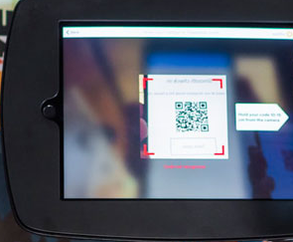
Essential
Covid case reports
data
Filtering and
Cross checking
Covid positive case detected
Alert Message
Shop Owner
Customers
Panchayath authorities
Quarantine

Slide 8
LINK TO PROTOTYPE VIDEO
https://app.animaker.com/animo/I0nI9iCmWdXPlKCZ/

Slide 9
TECHNOLOGY STACK USED
MySQL
Python
Cloud services
IOT

Slide 10
SOCIAL IMPACT ANALYSIS
Helps government to reduce the spread of covid
Automate human process
Prevent spread of covid due to close contact with the means of data entry used in conventional mode .
People get to know about the covid status of other people they mingled with.
Ensures quarantine of suspected individuals without any fail

Slide 11
CONCLUSION
Our initiative PAUSE TO RESUME is an efficient solution to reduce
the Spread of covid by strictly tracking the travel history of people without manual intervention and thereby quarantining individuals suspected to have covid.

Slide 12
THANK YOU

